Slide 1
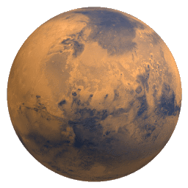
Determining the Elemental Composition of the Polar Latitudes of Mars using Gamma Ray Spectroscopy Data from the 2001 Mars Odyssey Investigation
Brett Courtright
Mentors: Bill Boynton and Dave Hamara
21 April 2012

Slide 2
Problem Statement
Elements in the Martian regolith (surface soil) emit gamma-rays due to cosmic-ray excitation.
These gamma rays are then detected by a gamma-ray spectrometer (GRS) aboard the Mars Odyssey satellite.
The GRS instrument counts the number of gamma rays as well as detects their energies.

Slide 3
Problem Statement
The problem with the GRS signal at the poles is two-fold:
There is an unknown amount of ice below the surface which decreases the gamma ray emissions due to dilution.
This same ice enhances thermal neutrons (excitation source of the gamma rays).
This ultimately increases the emission of gamma rays from the regolith that is associated with this ice.

Slide 4
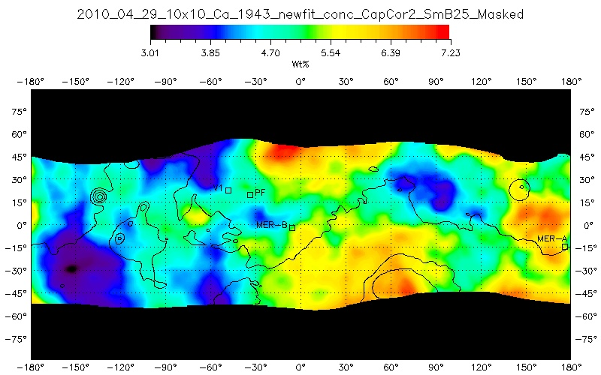
Problem Statement
Previously, the polar regions have been “masked” before publishing because it was unclear how to accurately process the data.
Ca via old method

Slide 5
Approach to Problem
A new processing method was developed to account for the two competing processes.
Following assumptions are made:
The weight percent of silicon is constant over the entire planet (ice-free basis at the poles).
Other elements experience the same dilution and neutron excitation as Si.

Slide 6
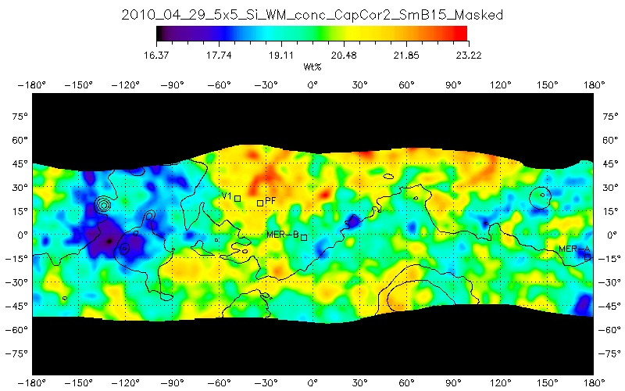
Approach to Problem
Most of this map is between 19 and 21%. The mid-latitude mean is taken to be 19.9 +/- 0.9
Si via old method

Slide 7
Approach to Problem
By dividing an elemental map by the silicon map and then multiplying by the average value of silicon over the mid-latitudes, the actual concentration over the whole planet is obtained.

Slide 8
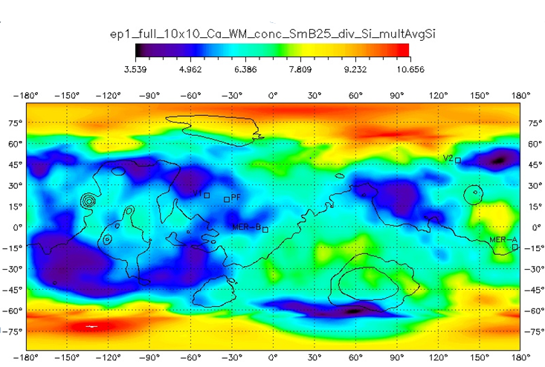
Results
Polar latitudes now have a concentration
Ca via new method

Slide 9
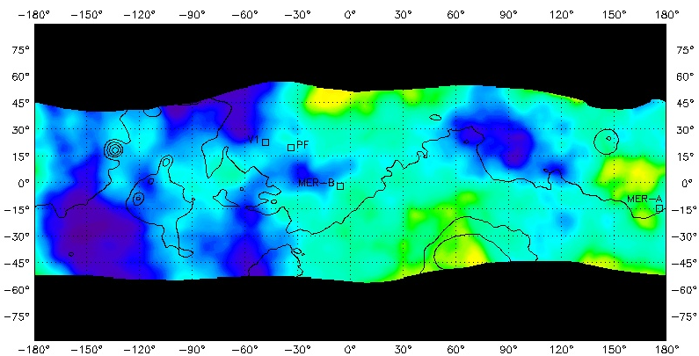
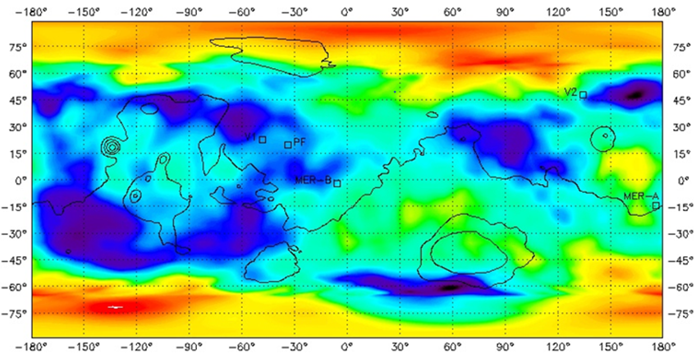
Results
Comparison of new map with old map
Ca via new method
Ca via old method

Slide 10
Results
Less uncertainty in the original masked map than in the new map.
Therefore, we would like to “stitch” the original mid-latitude map with the polar latitudes of the new map.
This provides a smaller uncertainty in the mid-latitudes but at the same time represents the polar concentrations.

Slide 11
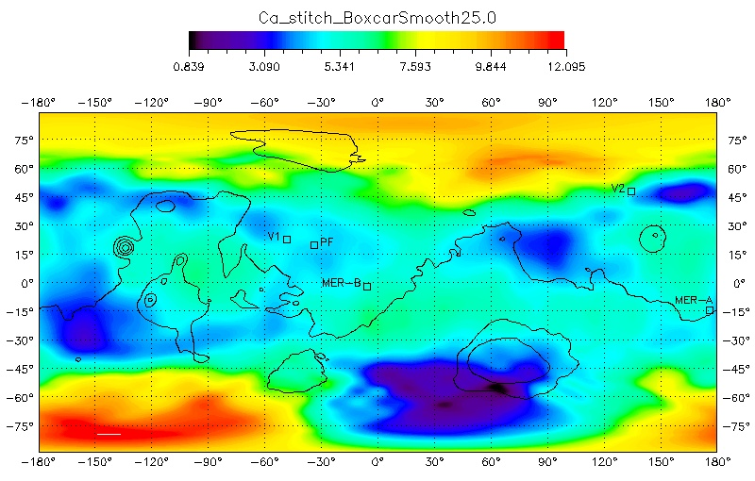
Results
Two maps “stitched” together.
Ca, new method and old method stitched together

Slide 12
Applications of Results
Maps made for Ca, Fe, Cl, S, Si, Al
With useful data at the poles, trends can be observed in the poles that might not be seen in the mid-latitudes.
For instance, the next two slides show that the Fe to S correlation is stronger in the polar latitudes than in the mid-latitudes.

Slide 13
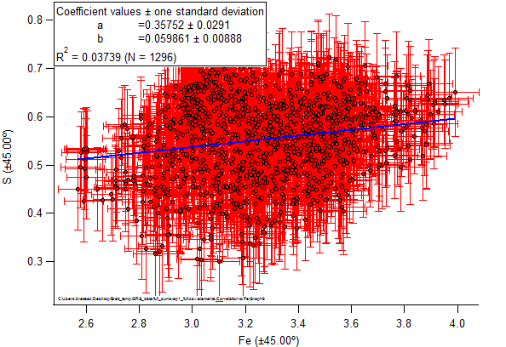
Applications of Results
S to Fe correlation in mid-latitudes
R² = 0.03739

Slide 14
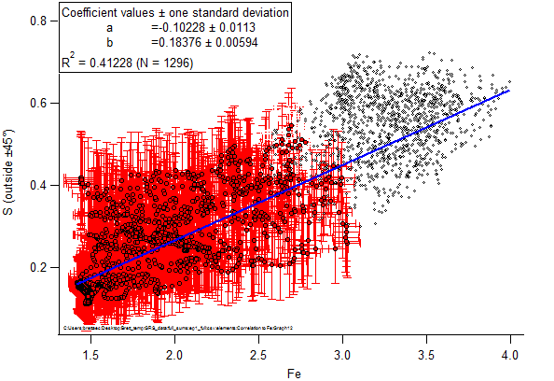
Applications of Results
S to Fe correlation in polar regions
R² = 0.41228
Note: the black dots represent the mid-latitude data points and are not included in this fit.

